Slide 1
CAPSTONE PROJECT
EDA on
Telecom Churn Analysis
Ajith R

Slide 2
CONTENT
Business Problem Understanding
Objective
Data Summary
Exploratory Data Analysis
Recommendation
Conclusion

Slide 3
BUSINESS PROBLEM UNDERSTANDING
Customer churn in the telecom industry poses one of the most significant risks to loss of revenue.
The average churn rate in the telecom industry is approximately 1.9% per month, but could rise as high as 67% annually * as per survey conduct.
Since the cost of acquiring new customers is up to 25 times higher than the cost of retaining them, reducing the churn rate of customer is key.
To reduce customer churn, telecom companies need to predict which customers are at high risk of churn for this we taking advantage of the vast streams of rich telecom customer data.
This project aims to analyse the data to determine the cause of customer churn customers who are most likely subject to churn, and what to do to retain the most valuable customer.

Slide 4
OBJECTIVE
Maximize: Company's profit by retaining customer
Minimize: Customer churn by identifying the key cause of the problem
Business Constraint:
Provide offers and discount and improve the service quality without compromising with profit
Maintain company’s brand value

Slide 5
DATA SUMMARY
Numerical Data
Number vmail messages
Total day minutes
Total day calls
Total day charge
Total eve minutes
Total eve calls
Total eve charge
Total night minutes
Total night calls
Total night charge
Total intl minutes
Total intl calls
Total intl charge
Customer service calls
Account length
TELECOM DATASET
Categorical Data
State
International plan
Voicemail plan
Target Variable
Churn

Slide 6
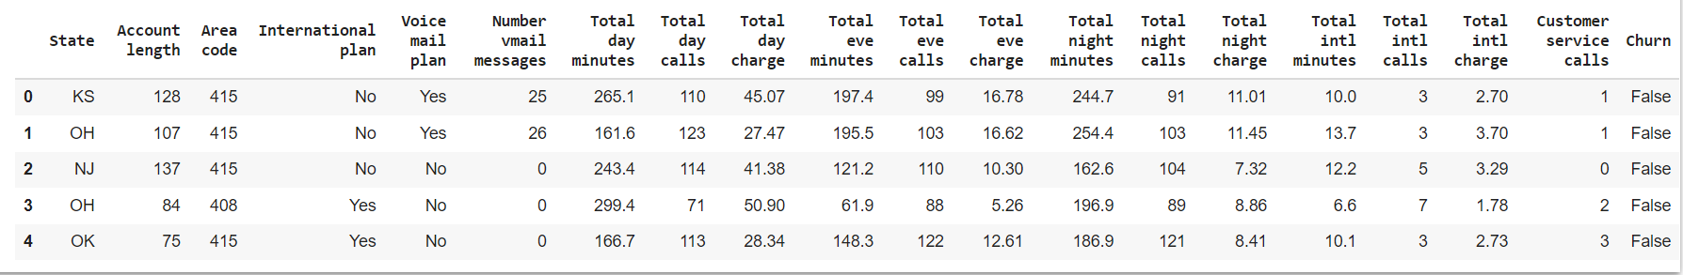
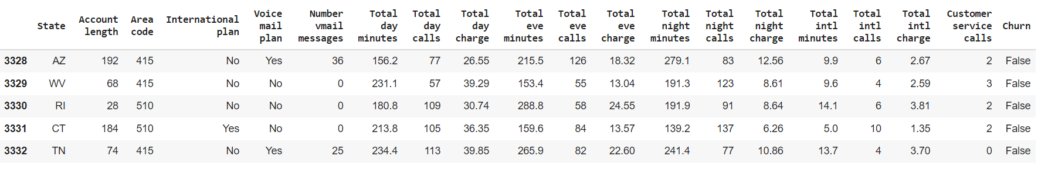
DATA SUMMARY
This is The Orange Telecom Churn Dataset.In the below table it’s show the top and bottom 5 rows respectively

Slide 7
FEATURES DESCRIPTION
STATE:There are 51 unique state present
ACCOUNT LENGTH:It is the length that the customer used their account
AREA CODE: There are 3 unique area code present
TOTAL (DAY/EVENING/NIGHT/INTERNATIONAL) (MINUTES/CALLS/CHARGES):
These are total 12 columns, and all are numerical data types.These contain the data of calls, minutes, charges of the customer with respective to the various time of the day and plan.
INTERNATIONAL PLAN & VOICEMAIL PLAN:
Both column are described as a categorical feature,yes means plan taken no means plan not taken
NO. OF VOICEMAIL MESSAGES:The number of voicemail made by the customer
Customer service calls:It is the number of calls made by the customer to operator service centre
Churn:it is our target dependent variable having boolean data type of true and false

Slide 8
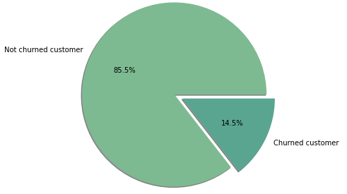
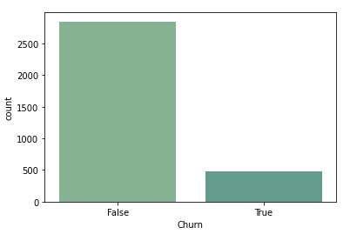
ANALYZING DEPENDENT VARIABLE “CHURN”
Below plot on the left side is a pie plot shows the percentage of total churned and not churned customer
And on the right side count plot shows the number of customer churned and not churned

Slide 9
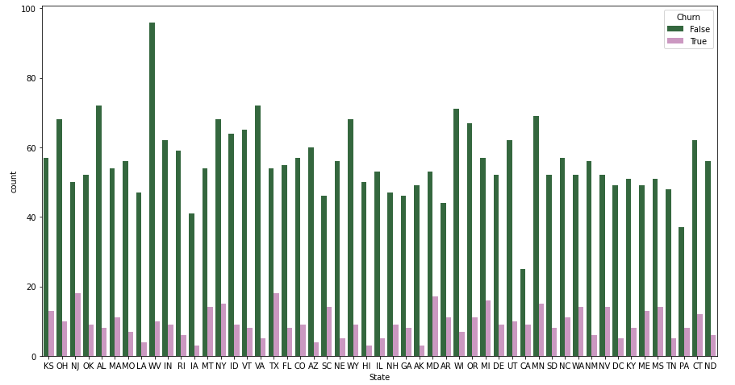
ANALYSIS STATE COLUMN
This Plot shows the Churn in each state

Slide 10
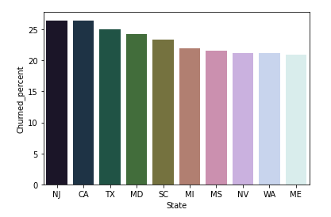
TOP STATE CHURN PERCENTAGE
NJ , CA, TX , MD ,SC ,MI, MS, NV, WA, ME are the States with higher churn rate of more than 20.
NJ and CA States have equal churned rate
NV and WA States too have equal churned rate
HI State has the least churned rate compared to all States, AK and AZ States are preceding to it.

Slide 11
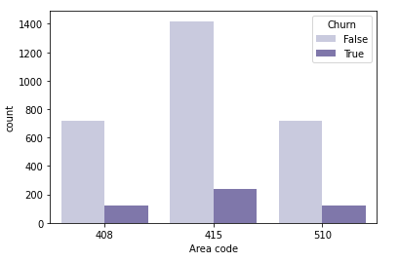
ANALYSIS OF AREA CODE
This plot graph shows all the values with churn
Area code has only 3 unique values, and also have equal number of churn

Slide 12
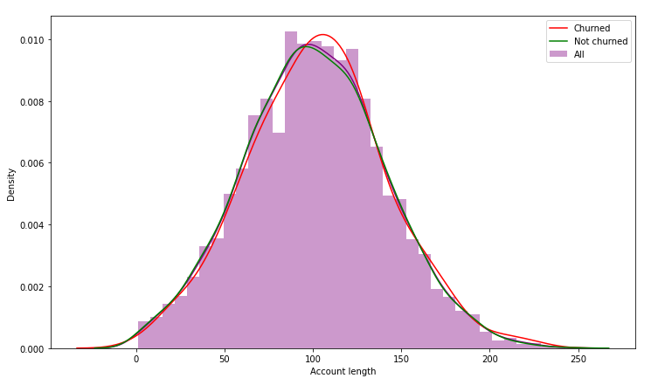
ACCOUNT LENGTH vs. CHURN
This Plot show effect of Account Length on Churn
Here is no sign of customers leaving because of the length of usage of their account.

Slide 13
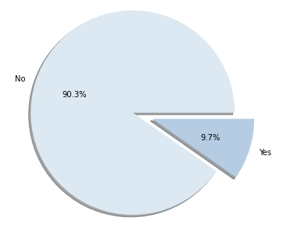
INTERNATIONAL PLAN
There are 3333 people
323 have a International Plan
3010 do not have International Plan

Slide 14
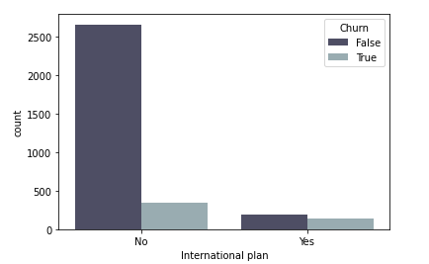
INTERNATIONAL PLAN vs. CHURN
This is a count plot which shows the churned and not churned customer respective to their international plan
Amongst those who have international plan 42.4 % people churn.

Slide 15

INTERNATIONAL PLAN vs. CHURN
This side table map shows data about the percentage churn according to the international plan
Which clearly shows that the churn percentage is 42.41% who takes the international plan
That means there is some cause which effects the churn rate like call price or network issue

Slide 16
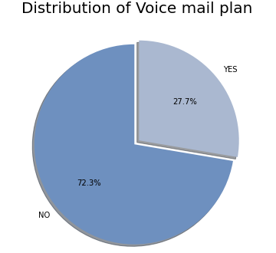
ANALYSIS OF VOICEMAIL PLAN
There are 3333 people,
922 having Voicemail plan,
2411 do not have any Voicemail plan.

Slide 17
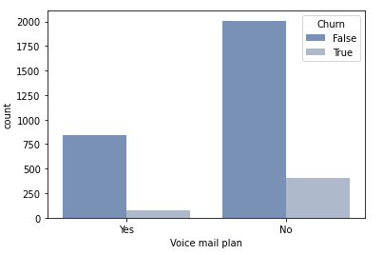
VOICEMAIL PLAN vs. CHURN
This plot shows churn corresponding with the subscription of voicemail plan
Out of all 922 people having Voicemail plan, 8.7% are Churn.

Slide 18
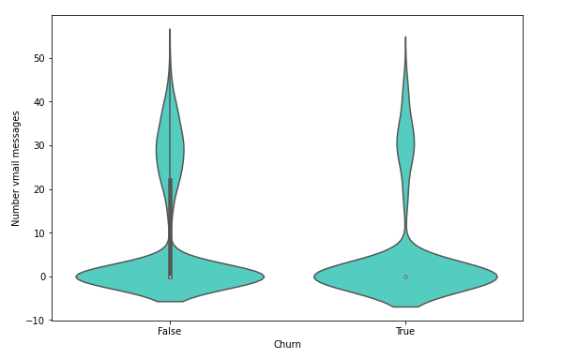
NO. OF VOICEMAIL vs.CHURN
This violin plot shows the relation between churn and no. of vmail
when there are more than 10 voicemail messages then there is a churn

Slide 19
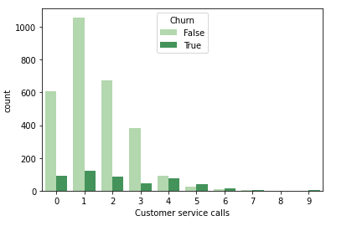
CUSTOMER SERVICE CALLS vs. CHURN
This plot shows Churn for number of customer service calls

Slide 20
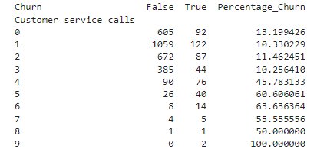
CUSTOMER SERVICE CALLS vs. CHURN
This table mapping number of customer calls to the churn percentage
It’s clear that after 4 calls at least 45% of the subscribers churn.
Customers with more than 4 service calls their probability of leaving is more

Slide 21
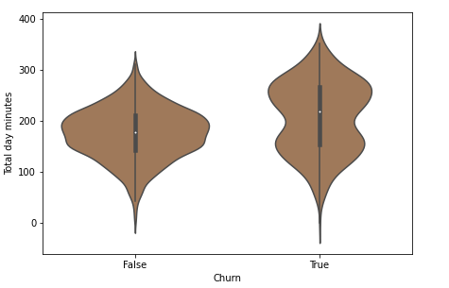
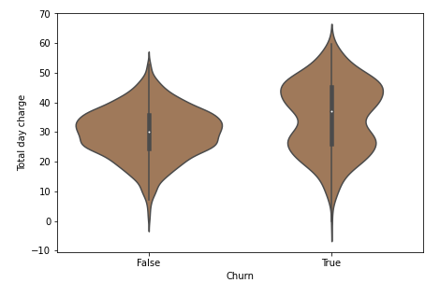
DAY CALL MINUTES & DAY CALL CHARGE vs. CHURN
Left side violin-plot shows the relation between total day minutes with churn
Right side violin--plot shows the relation between total day call charges with churn
Below violin-plot shows that with users spending more 250 minutes or more tend to switch to other operator.
The customer who have high call minutes also have high call price these tends to churn

Slide 22
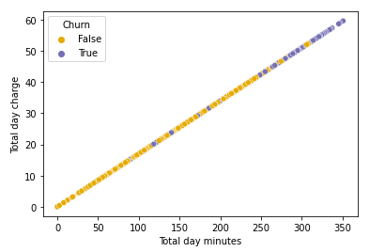
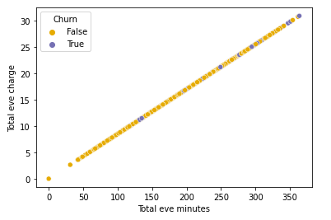
ANALYZING ALL CALLS MINUTES,ALL CALLS, ALL CALLS CHARGE
Below plots are scatter plot which shows the relation between calls and churn
Left side plot shows the Total day minutes,Total day charge
With churn
Right side plot shows the Total eve minutes,Total eve charge
With churn

Slide 23
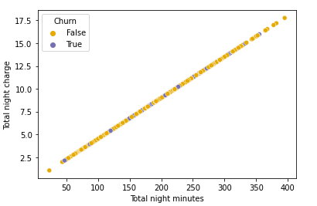
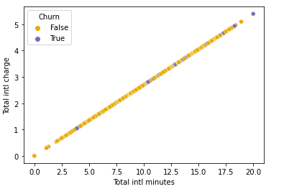
ANALYZING ALL CALLS MINUTES,ALL CALLS, ALL CALLS CHARGE
Left side scatter plot shows the Total night minutes,Total night charge
With churn
Right side plot shows the Total international minutes,Total international charge With churn

Slide 24
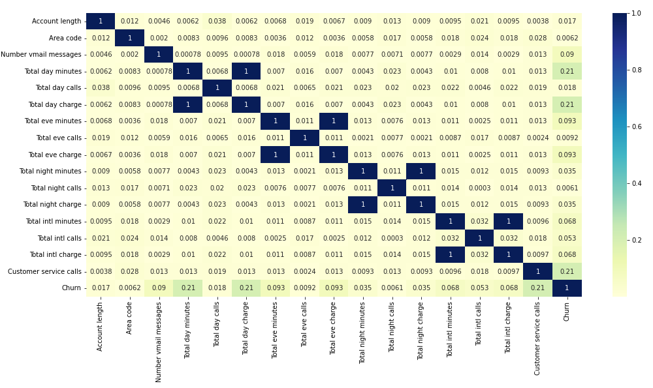
CORRELATION MATRIX

Slide 25
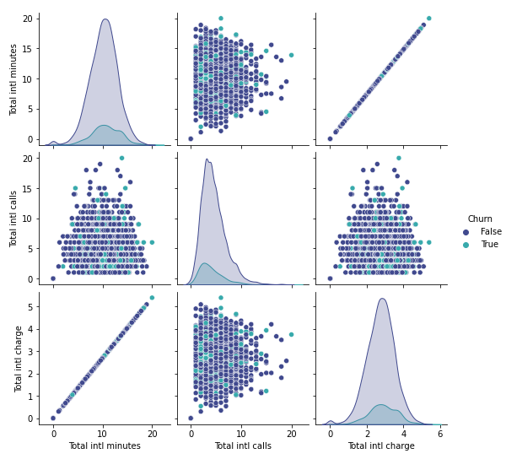
International call columns

Slide 26
CONCLUSION
Some states have higher churn rate than other, for which network issues could the reason.
Area and Account length has no relation with churn rate, hence this columns can be omitted.
Customers with international plan ON has higher churn rate compared to customers with international plan OFF , this could be because of the high cost or network issues.
It could been seen that in vmail messages column that when there are more than 10 voice mail messages then there is a churn and is even more denser while the voicemail messages are at 30
Customers with higher day call mins has higher churn rate compared to other , could be because of the higher charges which is quite obvious, frequent caller might have found some other company offering.
With other variables such as evening ,night calls no relation could be found.
The churn rate increases as the call to the service center increases. Customers who have called customer service three or fewer times have a markedly lower churn rate than that of customers who have called customer service four or more times.

Slide 27
RECOMMENDATIONS
Improve network coverage churned state
Give discount or create a plan in which as the day call mins increases above certain level the charges decrease means they are charged lower as compared to normal per min.
lower the international plan or provide with some discounts if the company needs international customers to be retained.
They can provide better customer service and provide better problem solution, also take their feedback and work on the feedback suggested by the customers

Slide 28
THANK YOU

